Slide 1

Collaboration Web App for Community Empowerment
Empowering local communities with a digital platform for collaboration and resource sharing.
Ga
by Goshen Dala

Slide 2
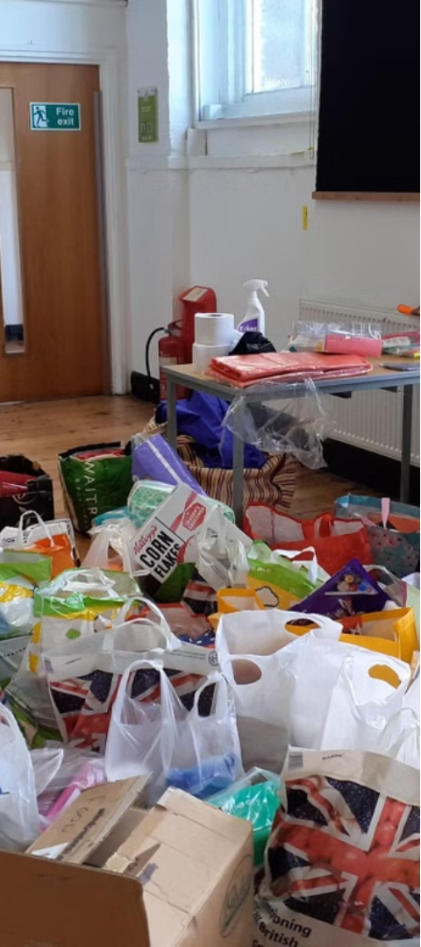
The Problem: Unemployment, Farmer Challenges, Women in Business Struggles
High Unemployment Rates
Challenges Faced by Farmers
Many young people in the local community face limited job opportunities, leading to widespread unemployment and underemployment, hindering their ability to support themselves and their families.
Local farmers struggle with unpredictable weather patterns, lack of access to modern farming technologies, and difficulty in reaching broader markets, limiting their productivity and profitability.
Barriers for Women in Business
Women entrepreneurs in the community often face gender-based biases, limited access to financing, and lack of business development support, making it difficult for them to establish and grow their ventures.

Slide 3
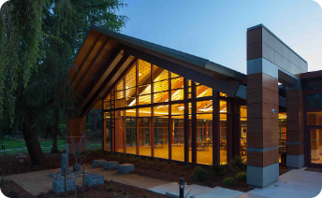
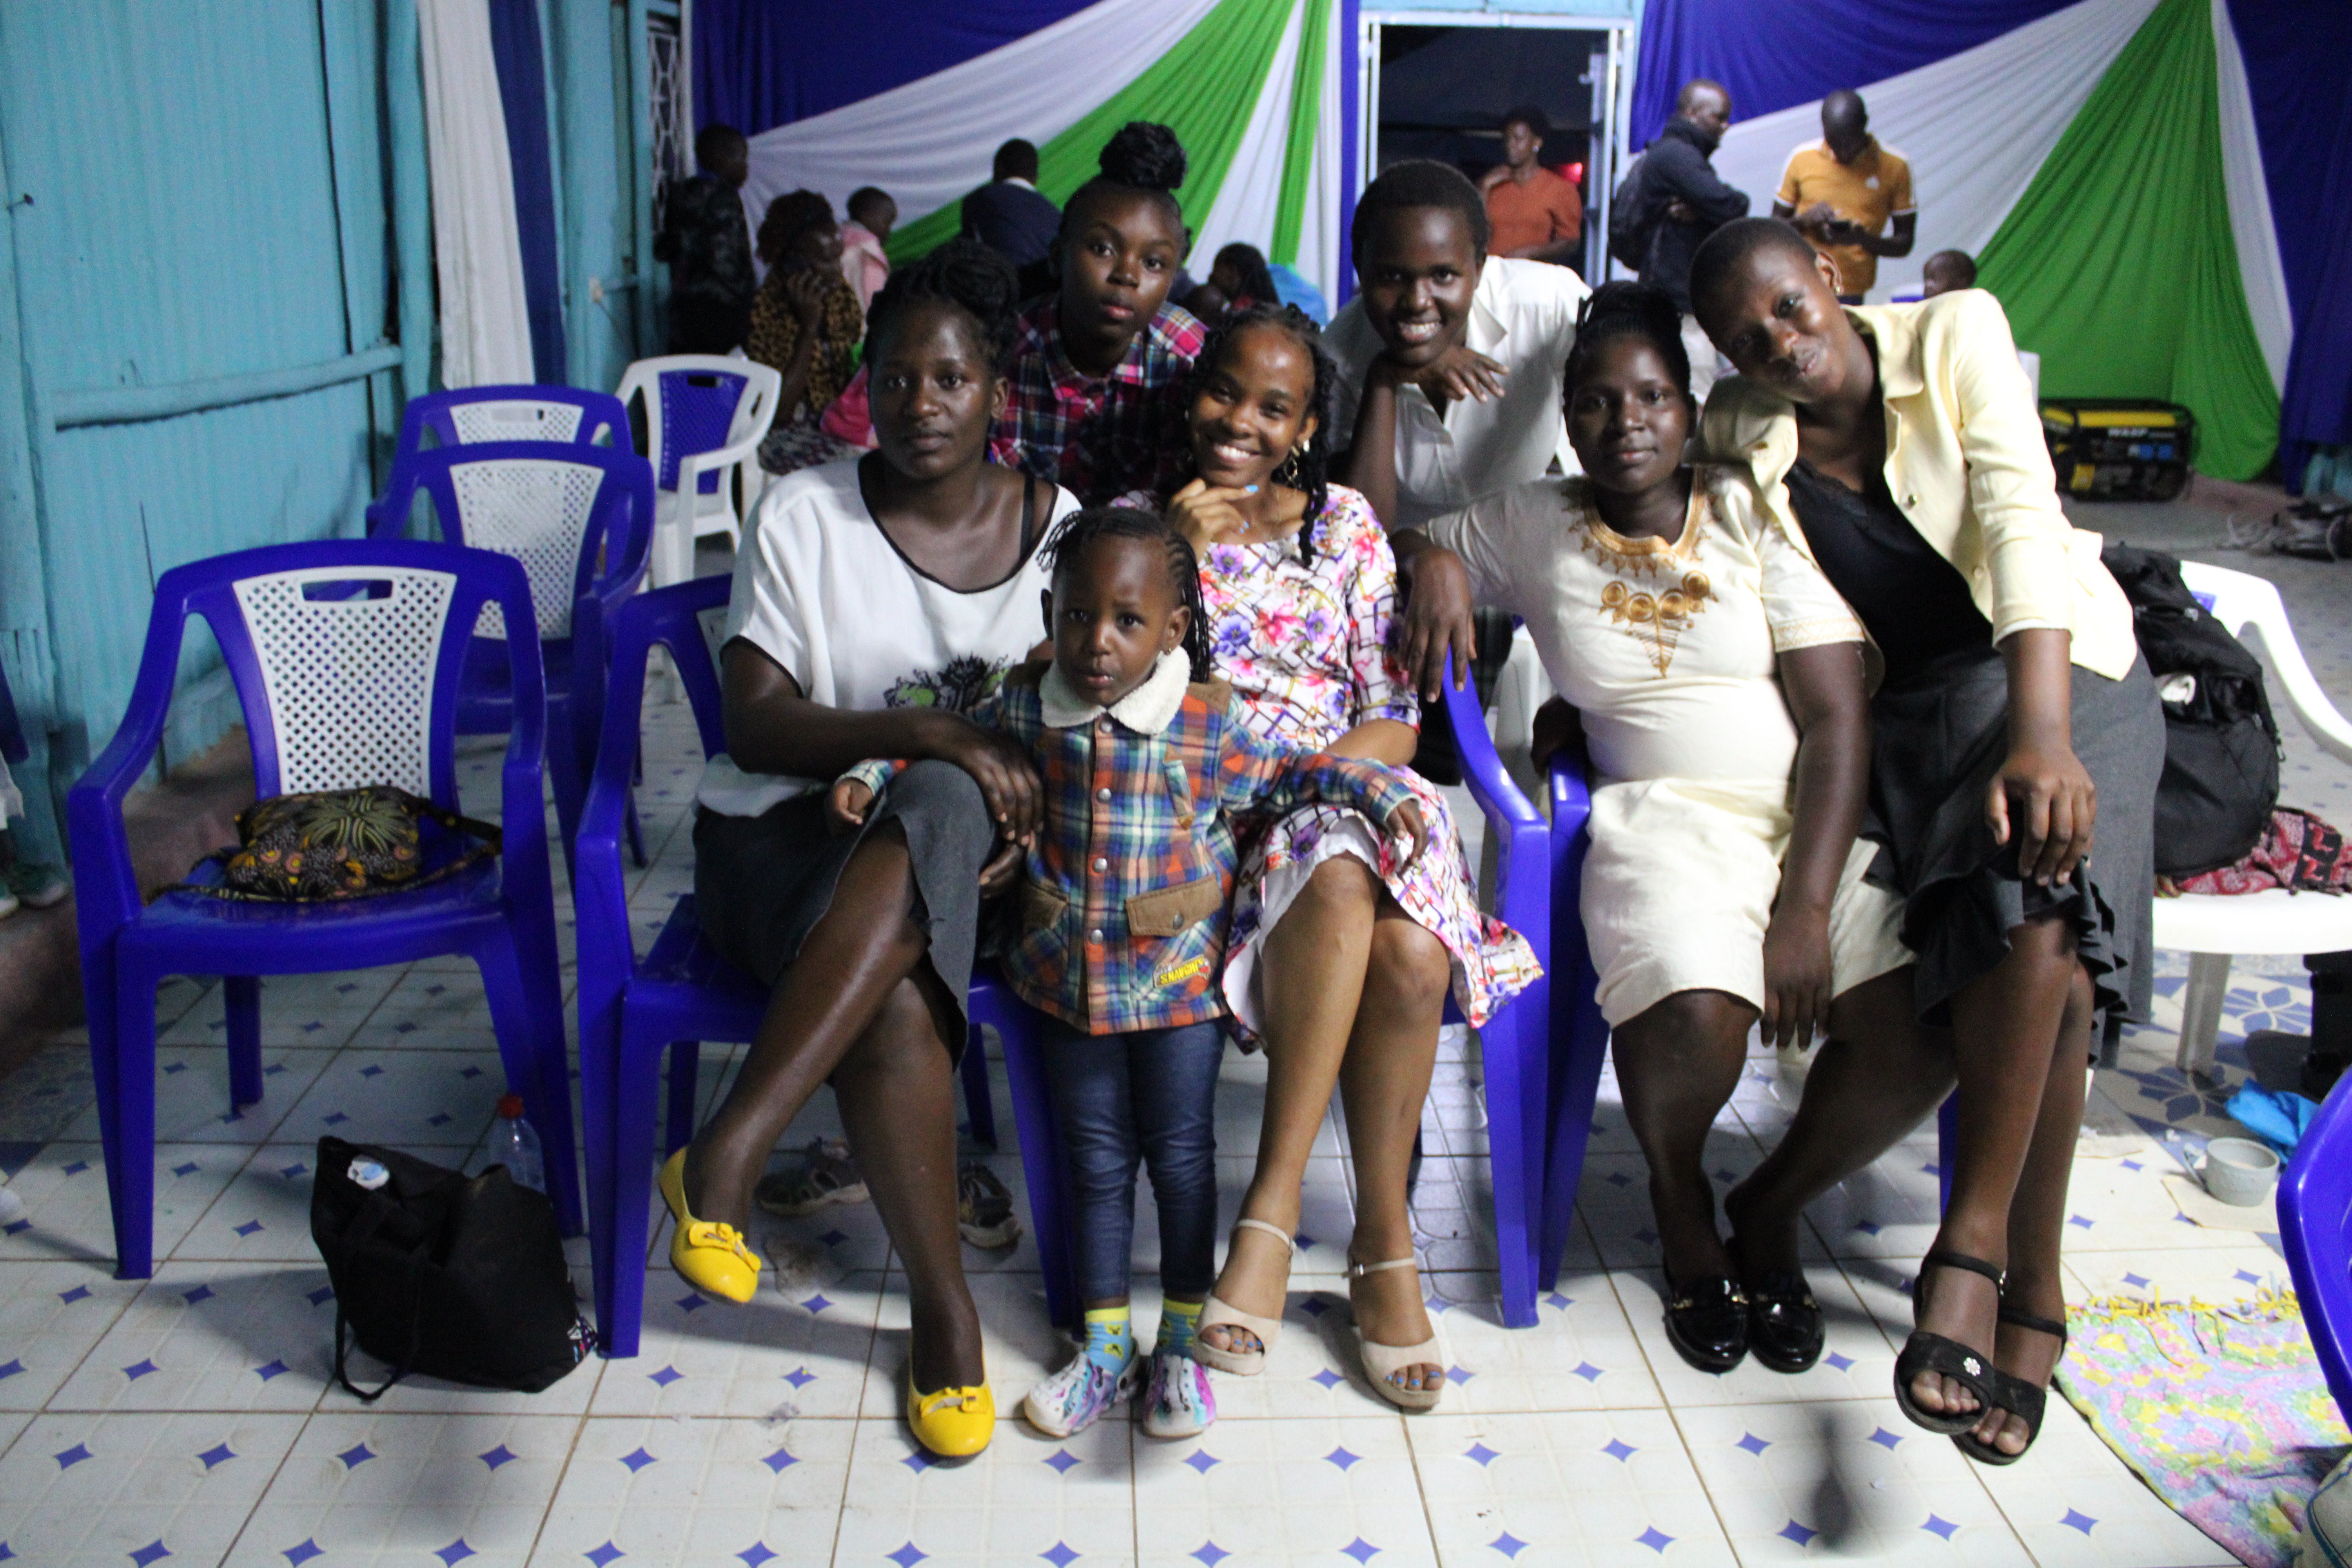
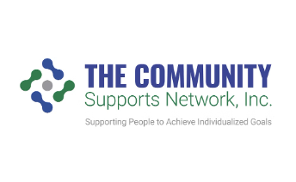
The Solution: Connecting and Empowering the Local Community
Centralized Hub
Skill-Building Workshops
Supportive Network
Our collaboration web app will serve as a centralized hub for the local community, connecting individuals, businesses, and organizations to share resources, find opportunities, and work together towards common goals.
By fostering connections and collaboration, the app will create a supportive network where community members can share advice, find mentors, and work together to address the unique challenges they face.
Through online courses and in-person workshops, the app will empower community members with the skills and knowledge they need to thrive, whether it's entrepreneurship training for women or agricultural best practices for local farmers.

Slide 4
Target Audience: 32,000 Households in the Local Community
Our collaboration web app is designed to empower a diverse population of 32,000 households within the local community. This underserved region faces challenges such as high unemployment, farmer struggles, and barriers for women in business.
32K
100%
Households
Community Impact
Our target audience spans 32,000 households in the local area.
We aim to positively impact 100% of these households through our collaborative solutions.

Slide 5
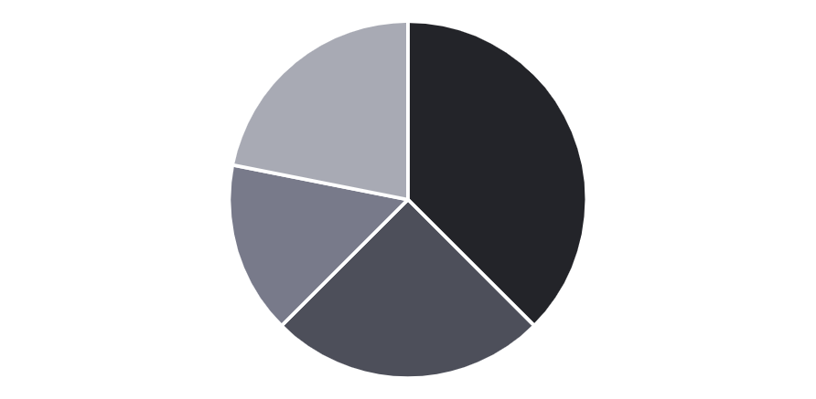
Market Opportunity: Underserved Population with Diverse Needs
The local community represents a vast, underserved market with diverse needs across employment, agriculture, and women's entrepreneurship. With a population of 32,000 households, this represents a significant opportunity to empower and connect this underserved population.
Unemployed Youth
Farmers
Women Entrepreneurs
Other Community Members
This diverse population faces a range of challenges, from lack of job opportunities for youth to insufficient support for farmers and women-led businesses. Our collaboration web app aims to connect and empower this underserved community.

Slide 6
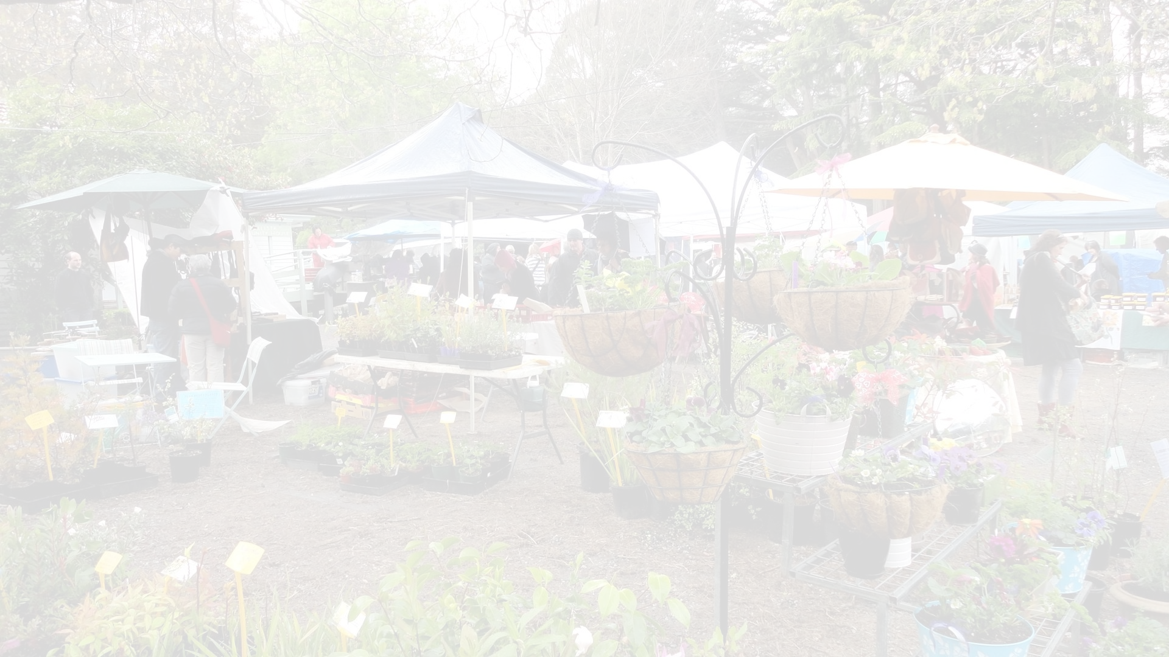
Competitive Landscape: Limited Existing Solutions
Fragmented Offerings
Limited Accessibility
Lack of Localization
Current solutions tend to focus on single aspects of community empowerment, lacking a comprehensive platform to address the diverse needs of the local population.
Existing tools can be difficult to navigate and access, particularly for the underserved and less tech-savvy members of the community.
Most available solutions are designed for general audiences, failing to cater to the unique cultural and regional requirements of the local community.

Slide 7
Competitive Advantage: Tailored and Inclusive
Tailored to Community Needs
Inclusive Design
Holistic Approach
We prioritize accessibility and inclusivity, ensuring our platform caters to users of diverse backgrounds, skills, and technological proficiencies, empowering the entire 32,000-household community.
By combining tailored features and inclusive design, our app provides a holistic solution that connects and uplifts the community, addressing their multifaceted needs in a comprehensive manner.
Our collaboration app is designed specifically to address the unique challenges faced by the local community, including unemployment, farmer struggles, and barriers for women in business.

Slide 8
Traction and Roadmap
Pilot Program
1
Initial launch in 3 local communities
Rapid Expansion
2
Scale to 10 additional communities within 6 months
Continuous Improvement
3
Gather user feedback and iterate on the platform
We will start with a pilot program in 3 local communities to test and refine our collaboration platform. Based on the learnings and traction from the pilot, we will rapidly expand to 10 additional communities within the first 6 months. Ongoing user feedback will drive continuous improvement of the platform to better meet the evolving needs of our community members.

Slide 9



Business and Revenue Model
Subscription
Partnerships
Grants
Users will pay a monthly or annual subscription fee to access the full platform and its advanced features.
We will establish strategic partnerships with local organizations, businesses, and government agencies to expand our reach and offer complementary services.
We will actively seek out grants and funding opportunities from philanthropic foundations and government programs to support our mission and growth.

Slide 10



Go-to-Market Strategy: Grassroots Outreach, Strategic Partnerships, Digital Presence
Grassroots Outreach
Strategic Partnerships
Digital Presence
Engage directly with the local community through events, workshops, and door-to-door campaigns to raise awareness and drive signups.
Establish a strong online presence through a user-friendly website, social media channels, and targeted digital marketing to attract and retain users.
Collaborate with local organizations, government agencies, and influential community leaders to leverage their networks and reach a wider audience.

Slide 11
Our Ask
Funding: Seeking $500,000 to scale our programs over the next two years, ensuring we can reach and support all 32,000 households effectively.
- Partnerships: Looking for partnerships with local and international organizations that can provide additional resources and expertise.
- Volunteers and Experts: Call for skilled volunteers and experts to join our mission and contribute to our training and mentorship programs.

Slide 12
Our Team
Vivian, Evelyn, and Jared: Each brings a professional background in community development with extensive experience in working directly with community members.
- Vivian: Specializes in youth employment programs, with over 10 years of experience in job training and placement.
- Evelyn: Focuses on agricultural development, providing expertise in sustainable farming and market access.
- Jared: Leads women’s entrepreneurship initiatives, with a strong background in business training and microfinance.

